Slide 1

Welcome To Madison Central
Making A Plan for High School and Beyond

Slide 2
Meet Your Counselors
Tammy Scott A-D tscott@madison-schools.com
Chandra Hays E-K chays@madison-schools.com
Cindy Lloyd L-R clloyd@madison-schools.com
Jessica Peacock S-Z jessica.peacock@madison-schools.com

Slide 3

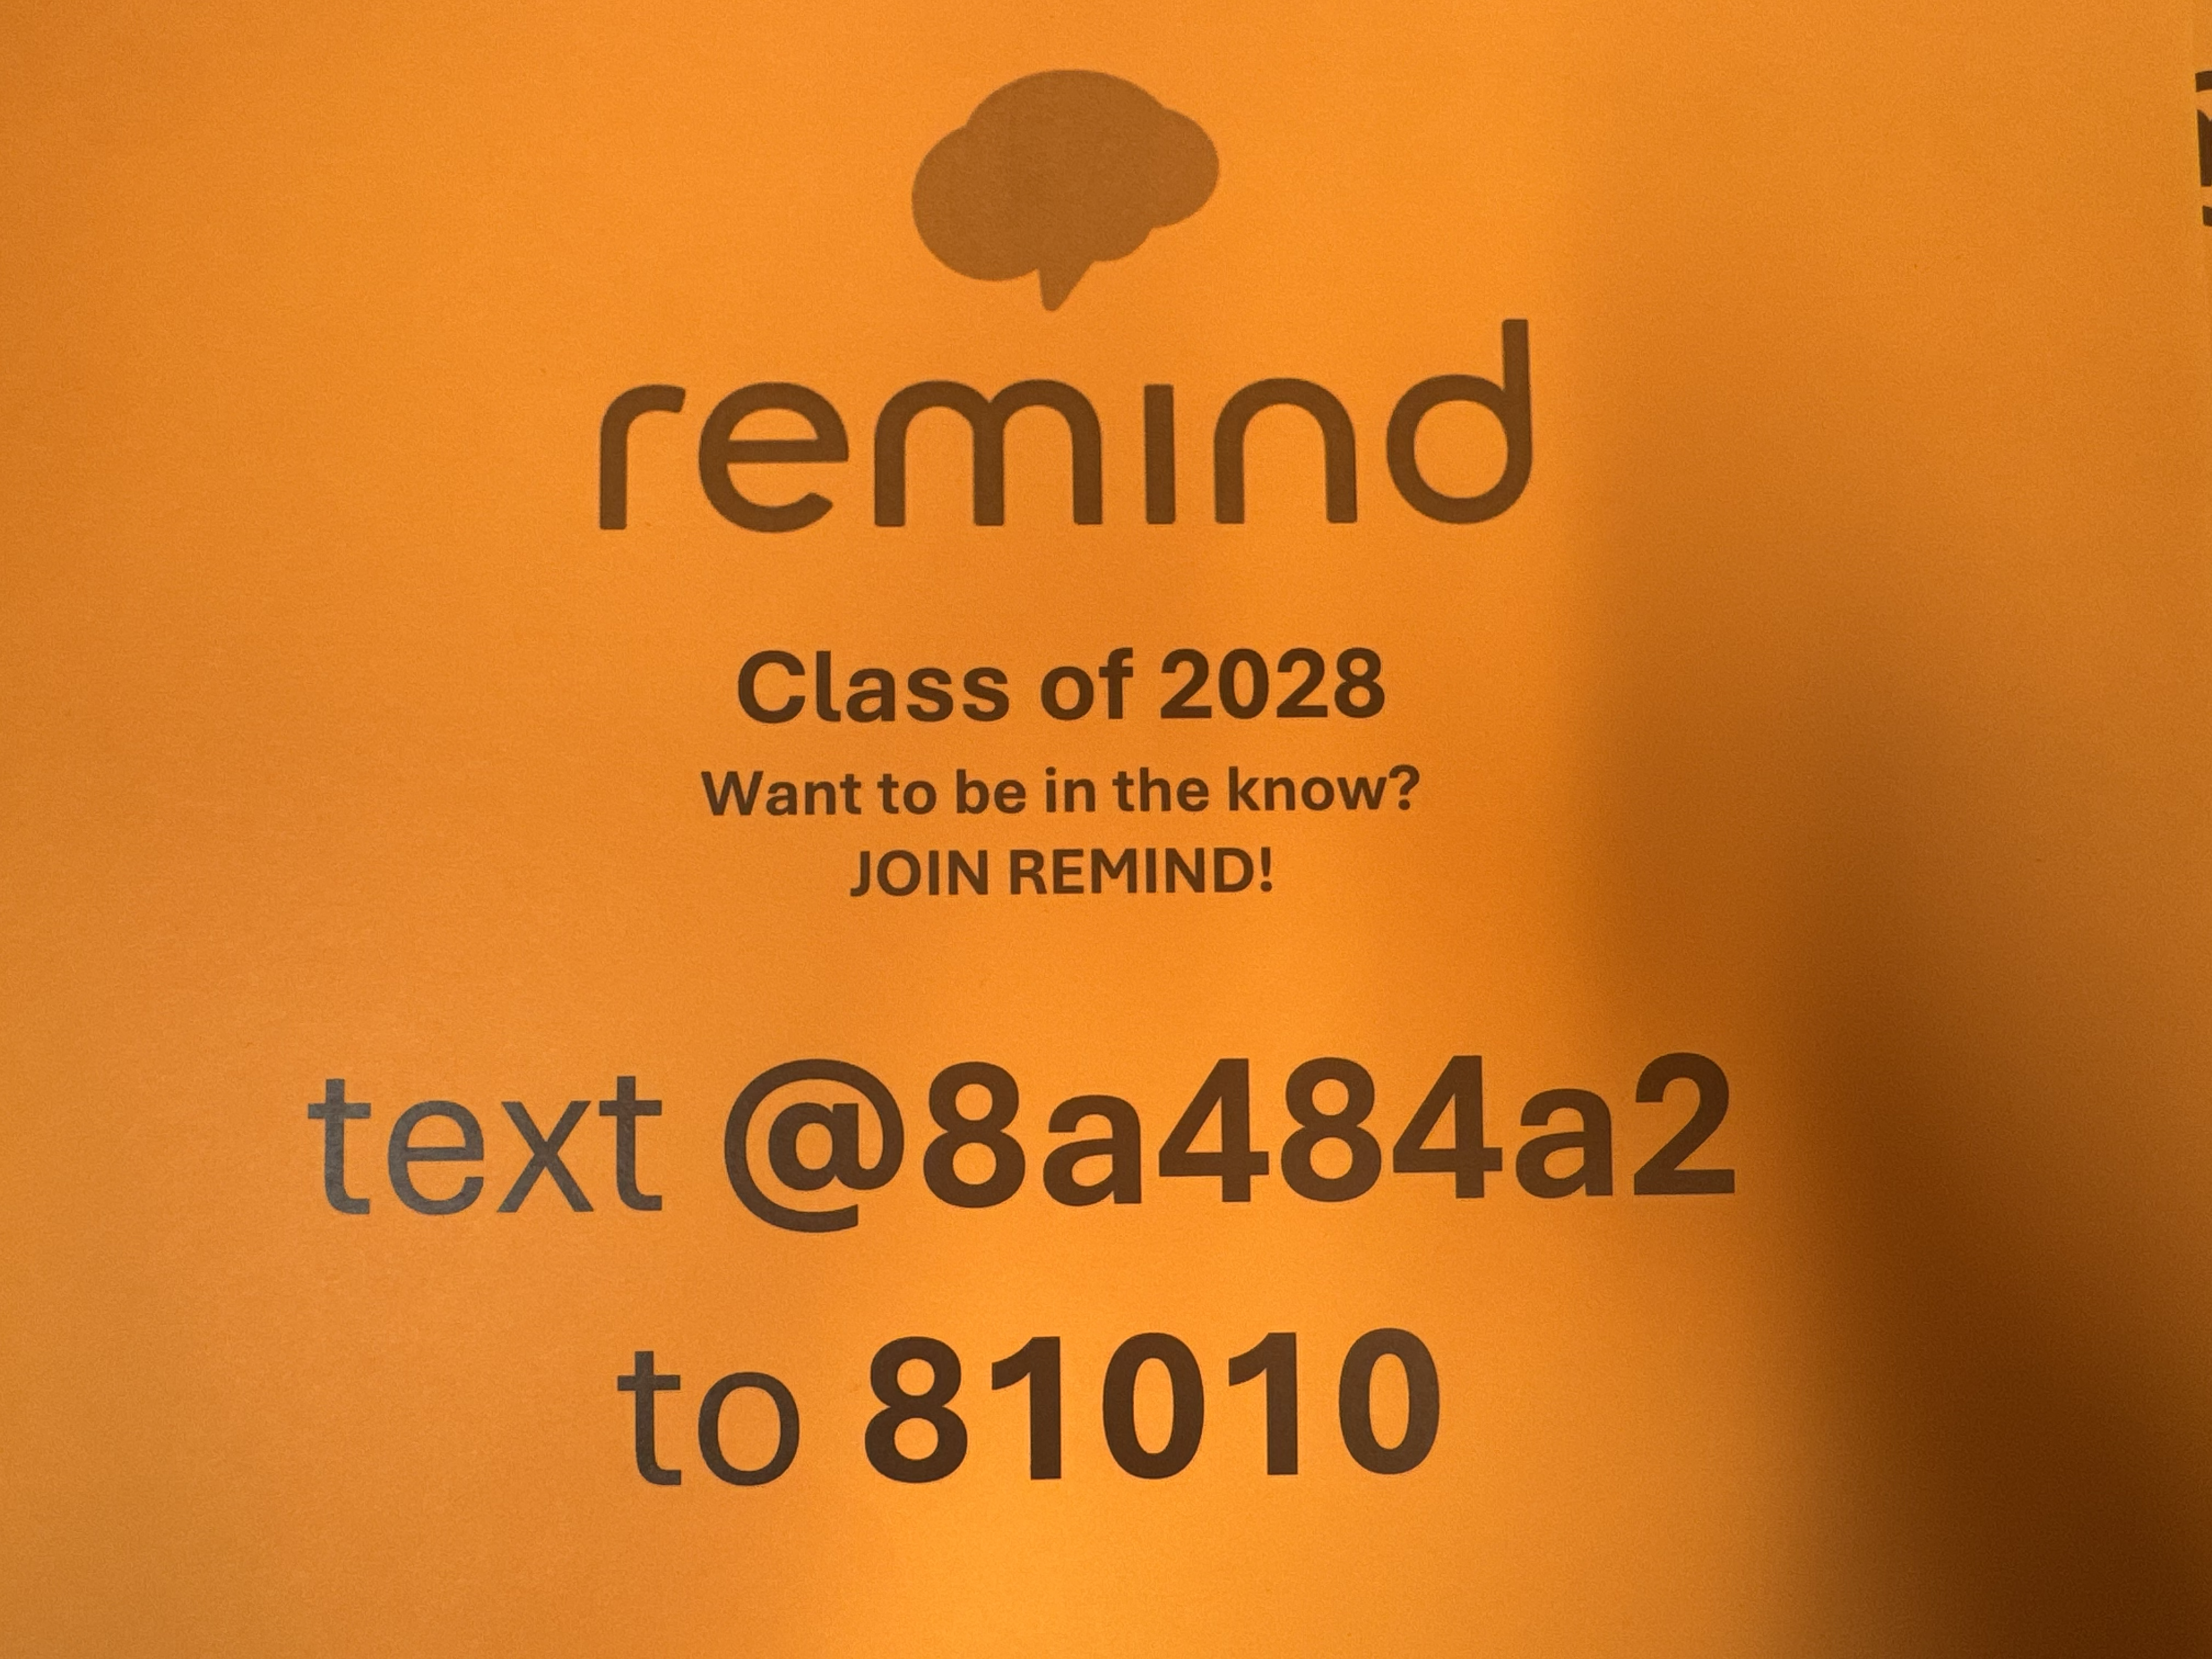
Remind:
All things Class of 2028!!
Schedule Release Date in Active Student
Possible school walk through with schedule
Sophomore Opportunities (HOBY)

Slide 4

Exciting News
We have gone into English classes to walk students through selecting core courses in active student
Choice sheets have gone home with students for discussion with parents and signature
Students will need to select 3 alternate courses
Counselors are meeting with your student individually this week. (February 24-28 )
We will pick up choice sheets and answer any questions

Slide 5


Be on the lookout

Slide 8

Choice Sheets/Trifold
You may view the choice sheet on our website, mcjags.com, in the quick links section under students

Slide 9
Class Flow
English
Math
Social Studies
English II
English II Acc.
Algebra I
Geometry
Algebra II
Algebra III/AP Pre Calculus
US Government
AP US Government

Slide 10
Class Flow Continued
Science
BIOLOGY
STUDENTS CHOICE

Slide 11
Summary of Diploma
Traditional
24.5 Credits
College and Career Readiness A
College and Career Readiness B
3 Sciences (Biology)
                UNIVERSITY
                2 ADVANCED ELECTIVES

Slide 12
Career and Technical Endorsement
Academic Endorsement
Distinguished Academic Endorsement

Slide 14

Dual Credit Requirements
ACT Composite: 18
3.0 GPA
ACT English: 17 for Comp. 1 and 2
ACT Math: 19 for College Algebra
Composite of 18 for Art Appreciation

Slide 15

The World of
Accelerated & Advanced Placement
Prerequisites can be found on the choice sheet

Slide 16
AP Permission Form
Students will not be allowed to drop AP course (s) after June 1st, 2025.

Slide 17

Accelerated Classes
Are offered in English grades 10-11

Slide 18
Advanced Placement
There are 17 advanced placement courses offered in the areas of
English
Science
Math
Social Studies
Art
The complete list can be found in Student Services and under the Student Service tab at mcjags.com under general information.

Slide 19
Get involved in your school and community by:
Joining teams or clubs at school.
Clubs are listed at mcjags.com under Student Services tab and click general information
Join Youth Groups in your community
Volunteer at Churches, Daycares, Community events…etc.
If you have a talent like singing, drawing, dancing, etc., build a portfolio of your work.
Make connections with people who can write great recommendation letters about your work ethic and character.

Slide 21
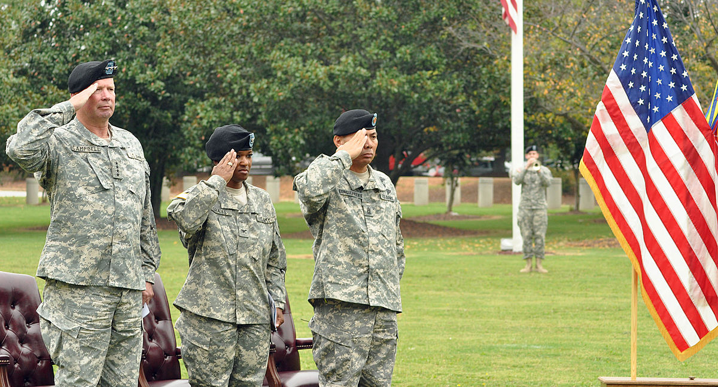


Start your research
Begin to put real thought into what you want to do after high school… will it be a 4 year College, a 2 year College, Trade School, the Military or the Workforce?
This Photo by Unknown Author is licensed under CC BY-NC-ND

Slide 22
In a Jagtastic World
Residency verifications will be due the latter part of June
1
Please ensure phone numbers and email information is up to date for parent contact
2
Summer reading requirements will be posted on mcjags.com website early June
(Accelerated & AP English only)
3
Parking Decals must be purchased for students who drive in the front office at MC
4

Slide 23


We will have SGA representatives, teachers, and staff available the first few days of school to welcome our sophomores and assist them with any questions and class location.

